Slide 1
Selenium OverView
- Jeet Kulkarni

Slide 2
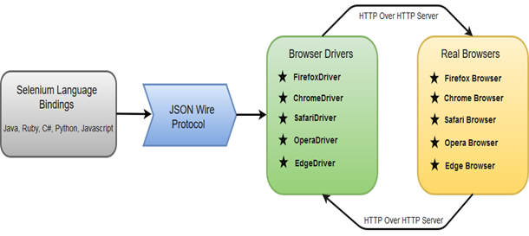
Selenium WebDriver - Architecture

Slide 3
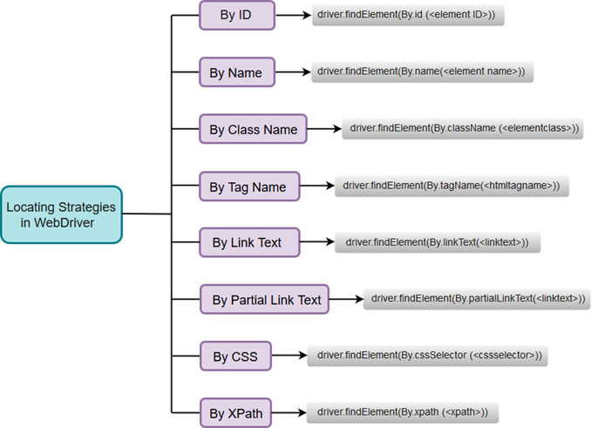
Selenium Locators

Slide 4
Practical example/snippet program using selenium

Slide 5
Thank You

